Slide 1
Unity Script Lifecycle
참고: https://docs.unity3d.com/kr/2022.3/Manual/ExecutionOrder.html

Slide 2
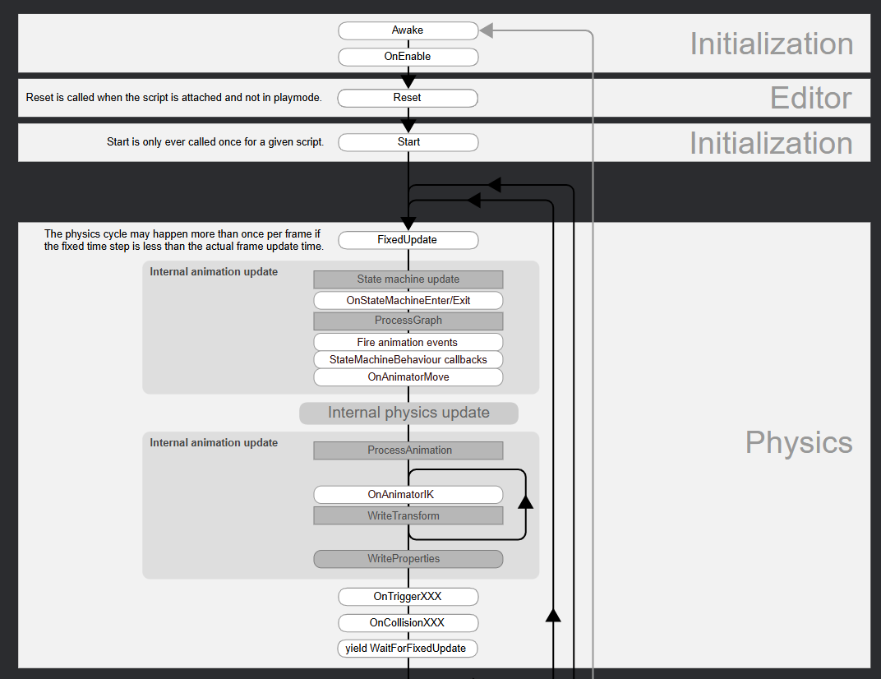

Slide 3
